Slide 1
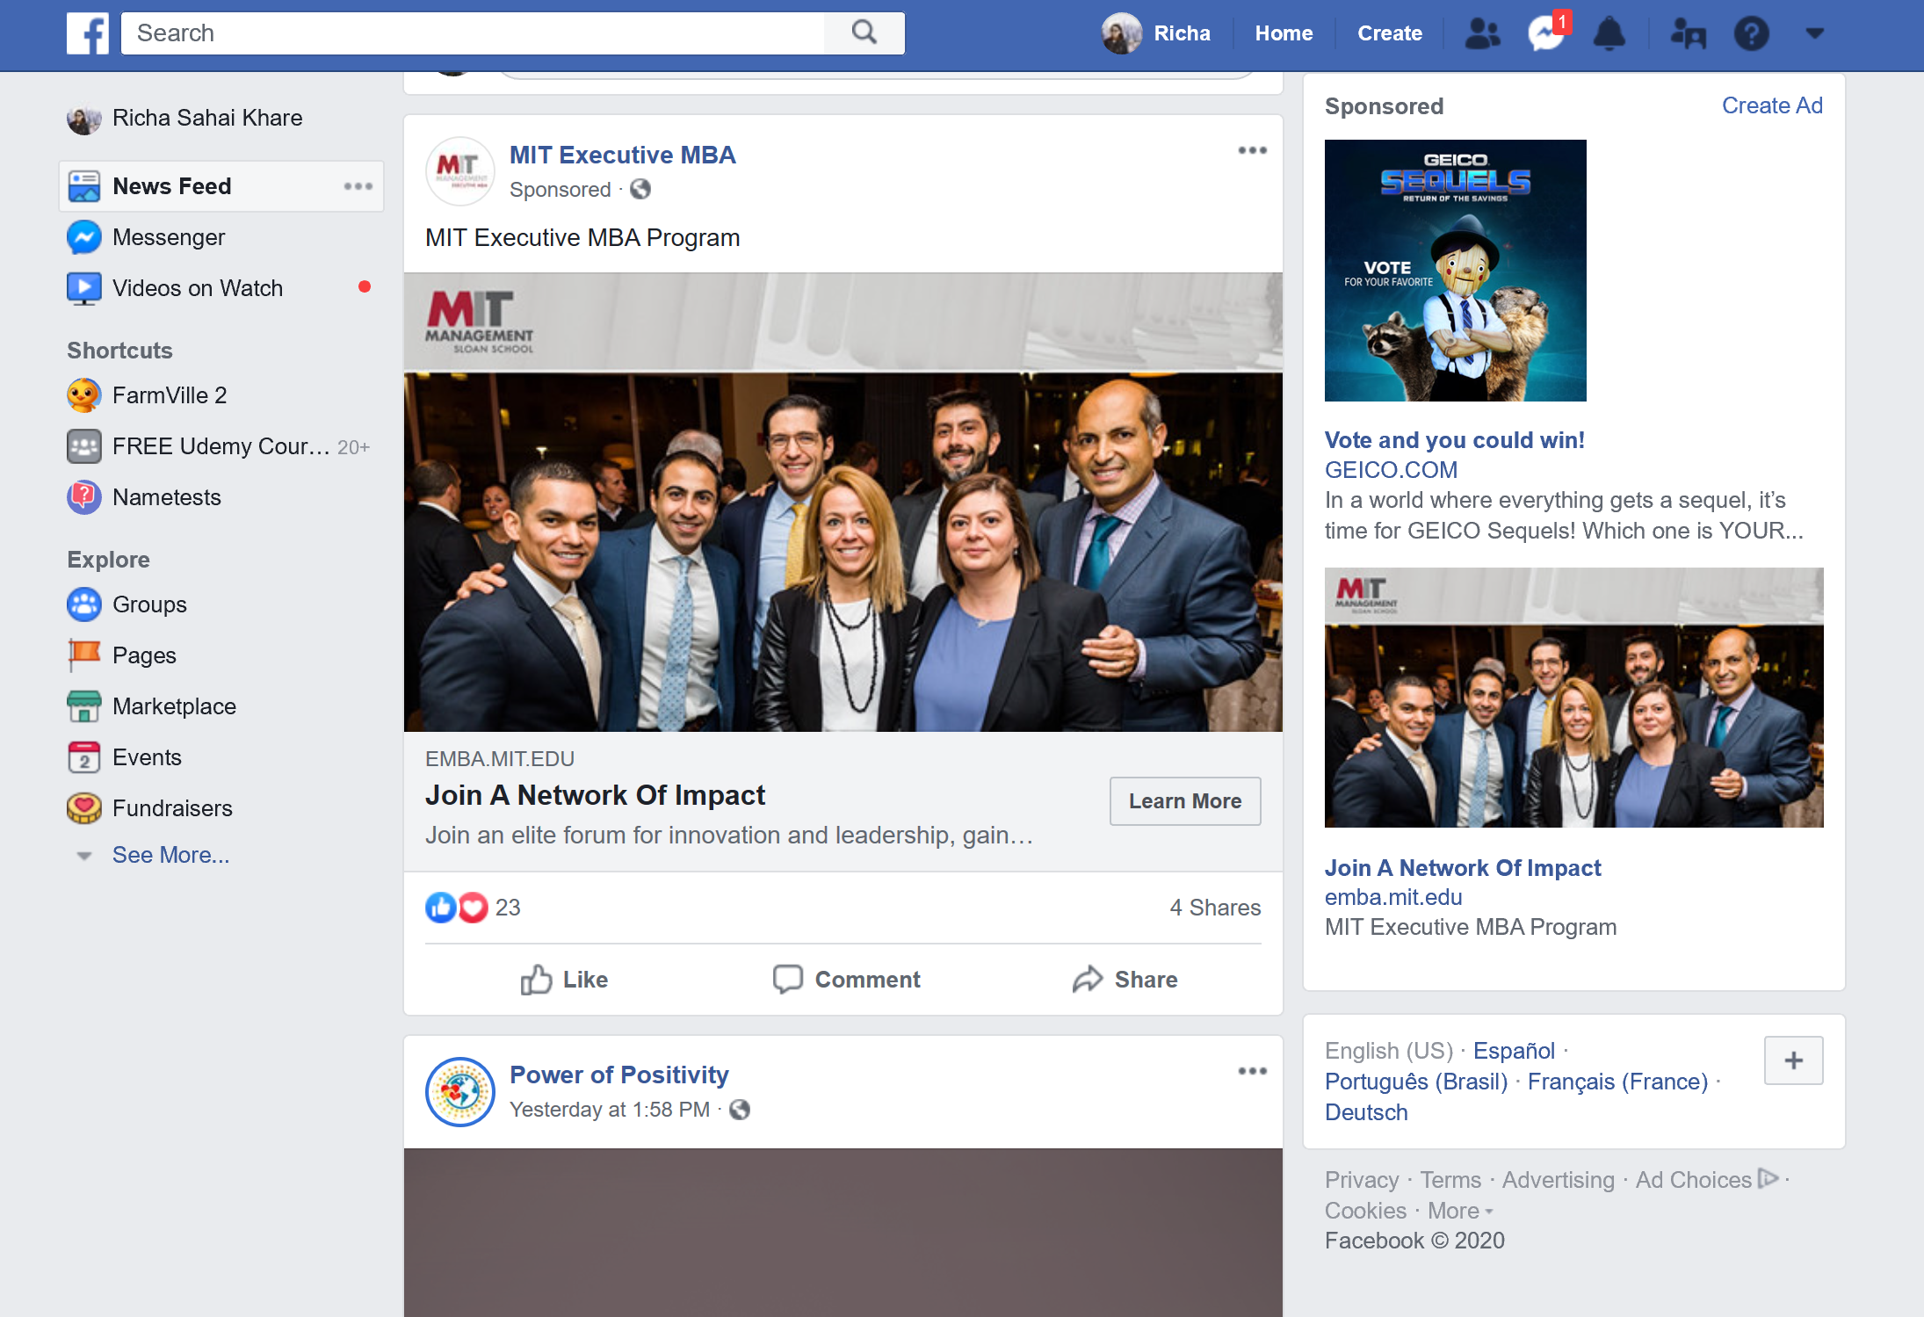
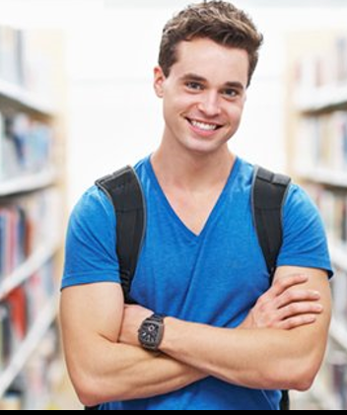



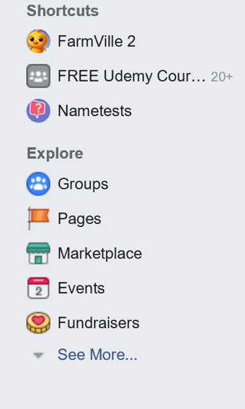
Brian
Brian
Music Buddy

Slide 2



Brian
Brian
Music Buddy

Slide 3






Search
MY BUDDY
Music for you
Top Charts
What my friends are hearing now
Most heard among my friends
Shared by my friends
Top songs in my group
MY MUSIC
Personal playlists
Shared playlists
My Artists
My Albums
My Favorites
My Followers
Following
My groups
EXPLORE
Featured Music
Recently heard
Top Genres/Moods ..
MY DOWNLOADS
SUBSCRIBE
To listen Ad free music
SETTINGS
ADVERTISEMENT
JAN 2020
DEC 2019
You created Tag #Nostalgic
NOV 2019
You have 10 new followers
You followed 5 friends
OCT 2019
You imported playlist “Our college Rocks” from Trevor.
MY BUDDY
Music for you
Top Charts
What my friends are hearing now SEE ALL
Most Heard Among my friends
This week This month This Year
Shared by my friends SEE ALL
Top Songs in my Groups
Group 1 Group 2
Songs you Like
Songs you Love
Songs that make you Laugh
Songs that make you sad
Songs that make you angry
You shared playlist “Amazing Songs”

Slide 4

Search
MY BUDDY
Music for you
Top Charts
What my friends are hearing now
Most heard among my friends
Shared by my friends
Top songs in my group
MY MUSIC
Personal playlists
Shared playlists
My Artists
My Albums
My Favorites
My Followers
Following
My groups
EXPLORE
Featured Music
Recently heard
Top Genres/Moods ..
MY DOWNLOADS
SUBSCRIBE
To listen Ad free music
SETTINGS
ADVERTISEMENT
JAN 2020
DEC 2019
You created Tag #Nostalgic
NOV 2019
You have 10 new followers
You followed 5 friends
OCT 2019
You imported playlist “Our college Rocks” from Trevor.
What my friends are hearing now ?
Song 1 (Album name – Singers) …
Song 2 (Album name – Singers) …
Song 3 (Album name – Singers) …
Song 4 (Album name – Singers) …
Song 5 (Album name – Singers) …
You shared playlist “Amazing Songs”
PLAY ALL

Slide 5
Perfect .
Ed Sheeran 0.43/4.12 .
Search
:
MY BUDDY
Music for you
Top Charts
What my friends are hearing now
Most heard among my friends
Shared by my friends
Top songs in my group
MY MUSIC
Personal playlists
Shared playlists
My Artists
My Albums
My Favorites
My Followers
Following
My groups
EXPLORE
Featured Music
Recently heard
Top Genres/Moods ..
MY DOWNLOADS
SUBSCRIBE
To listen Ad free music
SETTINGS
ADVERTISEMENT
JAN 2020
DEC 2019
You created Tag #Nostalgic
NOV 2019
You have 10 new followers
You followed 5 friends
OCT 2019
You imported playlist “Our college Rocks” from Trevor.
MY BUDDY
Music for you
Top Charts
What my friends are hearing now SEE ALL
Most Heard Among my friends
This week This month This Year
Shared by my friends SEE ALL
Top Songs in my Groups
Group 1 Group 2
Songs you Like
Songs you Love , Songs that make you feel wow,
Songs that make you Laugh
Songs that make you sad
Songs that make you angry
You shared playlist “Amazing Songs”

Slide 6

Perfect .
Ed Sheeran 0.43/4.12 .
Search
:
MY BUDDY
Music for you
Top Charts
What my friends are hearing now
Most heard among my friends
Shared by my friends
Top songs in my group
MY MUSIC
Personal playlists
Shared playlists
My Artists
My Albums
My Favorites
My Followers
Following
My groups
EXPLORE
Featured Music
Recently heard
Top Genres/Moods ..
MY DOWNLOADS
SUBSCRIBE
To listen Ad free music
SETTINGS
ADVERTISEMENT
JAN 2020
DEC 2019
You created Tag #Nostalgic
NOV 2019
You have 10 new followers
You followed 5 friends
OCT 2019
You imported playlist “Our college Rocks” from Trevor.
MY BUDDY
Music for you
Top Charts
What my friends are hearing now SEE ALL
Most Heard Among my friends
This week This month This Year
Shared by my friends SEE ALL
Top Songs in my Groups
Group 1 Group 2
Songs you Like
Songs you Love , Songs that make you feel wow,
Songs that make you Laugh
Songs that make you sad
Songs that make you angry
You shared playlist “Amazing Songs”

Slide 7


Perfect .
Ed Sheeran 0.43/4.12 .
Search
:
Share
Add to my Fav
Add to my playlists
Add to Queue
Like
MY BUDDY
Music for you
Top Charts
What my friends are hearing now
Most heard among my friends
Shared by my friends
Top songs in my group
MY MUSIC
Personal playlists
Shared playlists
My Artists
My Albums
My Favorites
My Followers
Following
My groups
EXPLORE
Featured Music
Recently heard
Top Genres/Moods ..
MY DOWNLOADS
SUBSCRIBE
To listen Ad free music
SETTINGS
ADVERTISEMENT
JAN 2020
DEC 2019
You created Tag #Nostalgic
NOV 2019
You have 10 new followers
You followed 5 friends
OCT 2019
You imported playlist “Our college Rocks” from Trevor.
MY BUDDY
Music for you
Top Charts
What my friends are hearing now SEE ALL
Most Heard Among my friends
This week This month This Year
Shared by my friends SEE ALL
Top Songs in my Groups
Group 1 Group 2
Songs you Like
Songs you Love
Songs that make you Laugh
Songs that make you sad
Songs that make you angry
You shared playlist “Amazing Songs”

Slide 8
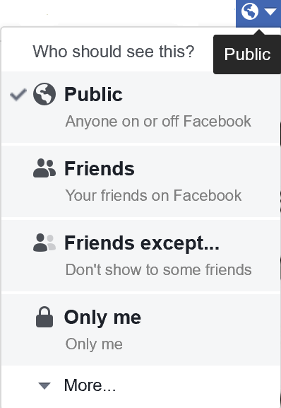
Perfect .
Ed Sheeran 0.43/4.12 .
Search
:
MY BUDDY
Music for you
Top Charts
What my friends are hearing now
Most heard among my friends
Shared by my friends
Top songs in my group
MY MUSIC
Personal playlists
Shared playlists
My Artists
My Albums
My Favorites
My Followers
Following
My groups
EXPLORE
Featured Music
Recently heard
Top Genres/Moods ..
MY DOWNLOADS
SUBSCRIBE
To listen Ad free music
SETTINGS
ADVERTISEMENT
JAN 2020
DEC 2019
You created Tag #Nostalgic
NOV 2019
You have 10 new followers
You followed 5 friends
OCT 2019
You imported playlist “Our college Rocks” from Trevor.
MY BUDDY
Music for you
Top Charts
What my friends are hearing now SEE ALL
Most Heard Among my friends
This week This month This Year
Shared by my friends SEE ALL
Top Songs in my Groups
Group 1 Group 2
Songs you Like
Songs you Love
Songs that make you Laugh
Songs that make you sad
Songs that make you angry
You shared playlist “Amazing Songs”

Slide 9

Perfect .
Ed Sheeran 0.43/4.12 .
Search
:
MY BUDDY
Music for you
Top Charts
What my friends are hearing now
Most heard among my friends
Shared by my friends
Top songs in my group
MY MUSIC
Personal playlists
Shared playlists
My Artists
My Albums
My Favorites
My Followers
Following
My groups
EXPLORE
Featured Music
Recently heard
Top Genres/Moods ..
MY DOWNLOADS
SUBSCRIBE
To listen Ad free music
SETTINGS
ADVERTISEMENT
MY GROUPS
MY FOLLOWERS SEE ALL
FOLLOWING SEE ALL
+ Create Group
+
MY MUSIC
Personal Playlists SEE ALL
Imported Playlists SEE ALL
My Artist SEE ALL
My Albums SEE ALL
My fav SEE ALL
My List
+ Create Playlist
+
+
+ Import Playlist
+
+
+
+
+

Slide 10
Perfect .
Ed Sheeran 0.43/4.12 .
Search
:
MY BUDDY
Music for you
Top Charts
What my friends are hearing now
Most heard among my friends
Shared by my friends
Top songs in my group
MY MUSIC
Personal playlists
Shared playlists
My Artists
My Albums
My Favorites
My Followers
Following
My groups
EXPLORE
Featured Music
Recently heard
Top Genres/Moods ..
MY DOWNLOADS
SUBSCRIBE
To listen Ad free music
SETTINGS
ADVERTISEMENT
MY GROUPS
MY FOLLOWERS SEE ALL
FOLLOWING SEE ALL
+ Create Group
+
MY MUSIC
Personal Playlists SEE ALL
Imported Playlists SEE ALL
My Artist SEE ALL
My Albums SEE ALL
My fav SEE ALL
My List
+ Create Playlist
+
+
+ Import Playlist
+
+
+
+
+

Slide 11
Perfect .
Ed Sheeran 0.43/4.12 .
Search
:
MY BUDDY
Music for you
Top Charts
What my friends are hearing now
Most heard among my friends
Shared by my friends
Top songs in my group
MY MUSIC
Personal playlists
Shared playlists
My Artists
My Albums
My Favorites
My Followers
Following
My groups
EXPLORE
Featured Music
Recently heard
Top Genres/Moods ..
MY DOWNLOADS
SUBSCRIBE
To listen Ad free music
SETTINGS
ADVERTISEMENT
EXPLORE
Featured Music
Top Charts
Recently Heard
Genres
Hip Hop Jazz Pop Metal And SO ON…..
Moods SEE ALL
Party Workout Wellness Romance

Slide 12
Perfect .
Ed Sheeran 0.43/4.12 .
Search by Hashtags !
:
MY BUDDY
Music for you
Top Charts
What my friends are hearing now
Most heard among my friends
Shared by my friends
Top songs in my group
MY MUSIC
Personal playlists
Shared playlists
My Artists
My Albums
My Favorites
My Followers
Following
My groups
EXPLORE
Featured Music
Recently heard
Top Genres/Moods ..
MY DOWNLOADS
SUBSCRIBE
To listen Ad free music
SETTINGS
ADVERTISEMENT
MY DOWNLOADS
Song 1 ( Album name – Singers) #Add hashtag …
Song 2 (Album name – Singers) #Add hashtag …
Song 3 (Album name – Singers) #Add hashtag …
Song 4 (Album name – Singers) #Add hashtag …
Song 5 (Album name – Singers) #Add hashtag …
Song 6 (Album name – Singers) #Add hashtag …
Song 7 (Album name – Singers) #Add hashtag …
PLAY ALL

Slide 13
Perfect .
Ed Sheeran 0.43/4.12 .
Search by Hashtags !
:
MY BUDDY
Music for you
Top Charts
What my friends are hearing now
Most heard among my friends
Shared by my friends
Top songs in my group
MY MUSIC
Personal playlists
Shared playlists
My Artists
My Albums
My Favorites
My Followers
Following
My groups
EXPLORE
Featured Music
Recently heard
Top Genres/Moods ..
MY DOWNLOADS
SUBSCRIBE
To listen Ad free music
SETTINGS
ADVERTISEMENT
MY DOWNLOADS
Song 1 ( Album name – Singers) #Nostalgic …
Song 2 (Album name – Singers) #Sunday party …
Song 3 (Album name – Singers) #Sunday Party …
Song 4 (Album name – Singers) #Nostalgic …
Song 5 (Album name – Singers) #Workout …
Song 6 (Album name – Singers) #Sleep …
Song 7 (Album name – Singers) #Sunday party …
PLAY ALL

Slide 14
Perfect .
Ed Sheeran 0.43/4.12 .
Sunday Party
:
MY BUDDY
Music for you
Top Charts
What my friends are hearing now
Most heard among my friends
Shared by my friends
Top songs in my group
MY MUSIC
Personal playlists
Shared playlists
My Artists
My Albums
My Favorites
My Followers
Following
My groups
EXPLORE
Featured Music
Recently heard
Top Genres/Moods ..
MY DOWNLOADS
SUBSCRIBE
To listen Ad free music
SETTINGS
ADVERTISEMENT
MY DOWNLOADS
Song 2 (Album name – Singers) #Sunday party …
Song 3 (Album name – Singers) #Sunday Party …
Song 7 (Album name – Singers) #Sunday party …
PLAY ALL

Slide 15
Perfect .
Ed Sheeran 0.43/4.12 .
Search by Hashtags !
:
MY BUDDY
Music for you
Top Charts
What my friends are hearing now
Most heard among my friends
Shared by my friends
Top songs in my group
MY MUSIC
Personal playlists
Shared playlists
My Artists
My Albums
My Favorites
My Followers
Following
My groups
EXPLORE
Featured Music
Recently heard
Top Genres/Moods ..
MY DOWNLOADS
SUBSCRIBE
To listen Ad free music
SETTINGS
ADVERTISEMENT
MY DOWNLOADS
Song 1 ( Album name – Singers) #Add hashtag …
Song 2 (Album name – Singers) #Add hashtag …
Song 3 (Album name – Singers) #Add hashtag …
Song 4 (Album name – Singers) #Add hashtag …
Song 5 (Album name – Singers) #Add hashtag …
Song 6 (Album name – Singers) #Add hashtag …
Song 7 (Album name – Singers) #Add hashtag …
PLAY ALL
Share
Add to my Fav
Add to a playlist
Add to Queue
Like

Slide 16
Perfect .
Ed Sheeran 0.43/4.12 .
Search
:
MY BUDDY
Music for you
Top Charts
What my friends are hearing now
Most heard among my friends
Shared by my friends
Top songs in my group
MY MUSIC
Personal playlists
Shared playlists
My Artists
My Albums
My Favorites
My Followers
Following
My groups
EXPLORE
Featured Music
Recently heard
Top Genres/Moods ..
MY DOWNLOADS
SUBSCRIBE
To listen Ad free music
SETTINGS
ADVERTISEMENT
SUBSCRIBE
Subscribe today to our premium plan to enjoy maximum benefits !
Ad free music
Unlimited downloads
Hash tag your downloaded content to quickly access favorite content you want
Access to all tracks you love
Register here for premium and enjoy FREE PREMIUM for 3 months. Cancel anytime!
*Family plan provides access to 5 people in a family
*Student plan provides all the premium benefits just at a lower cost !
BASIC PLAN
(Individual)
@9.99$ per month
FAMILY PLAN*
@14.99$ per month
STUDENT PLAN*
@4.99$ per month

Slide 17
Perfect .
Ed Sheeran 0.43/4.12 .
Search
:
MY BUDDY
Music for you
Top Charts
What my friends are hearing now
Most heard among my friends
Shared by my friends
Top songs in my group
MY MUSIC
Personal playlists
Shared playlists
My Artists
My Albums
My Favorites
My Followers
Following
My groups
EXPLORE
Featured Music
Recently heard
Top Genres/Moods ..
MY DOWNLOADS
SUBSCRIBE
To listen Ad free music
SETTINGS
ADVERTISEMENT
SETTINGS
Language : English
Notifications Settings
Download Settings
Privacy Settings
Account information : facebook ID/email
Need help?
Help ( Offline FAQs)
Log out

